Slide 1
Process Overview, System Conception, Domain Analysis

Slide 2
Software development process **
A software development process provides a basis for the organized production of software, using a collection of predefined techniques and notations.

Slide 3
Development stages (SAS CIT TDM)
System Conception
Analysis
System design
Class design
Implementation
Testing
Training
Deployment
Maintenance

Slide 4
System conception:
It deals with the origin of an application and formulate tentative requirements.
Analysis:
The goal of analysis is to specify what needs to be done, not how it is done. One must understands a problem before attempting a solution.
Domain analysis is mainly to decide which information to capture and how to represent it.
Application analysis that address the computer aspects of the application that are visible to users.

Slide 5
System design:
The architecture is the strategy for solving the application problems. The choice of architecture is based on the requirements as well as past experience.
During this process the developer makes strategic decisions with broad consequences.
Class design:
The developer expands and optimizes the models; there is a shift in emphasis from application concepts towards computer concepts.

Slide 6
Implementation:
Stage of writing the actual code. Developers map design elements to programming languages and database code.
Testing:
To verify that the system delivers the proper functionality .
Developers checks programs at several levels. Unit tests and System tests.
Training:
An organization must train users so that they can fully benefit from an application.

Slide 7
Deployment:
The eventual system must work in the field, on various platforms and in various configurations.
Maintenance :
Once development is complete and system has deployed, it must be maintained for continued success.

Slide 8
Development life cycle
An OO approach to software supports multiple life-cycle styles.
Waterfall development
Is a linear sequence with no backtracking. Developers first captures the requirements, then analysis, system design, implementation, testing, deployment.
Each stage is completed before the next stage is begun.
This model is suitable for well-understood applications with predictable outputs.

Slide 9
Iterative development
It is more flexible. First you develop the nucleus of a system-analyzing, designing, implementing, and delivering working code.
Then you grow the scope of the system, adding properties and behavior to existing objects, as well adding new kinds of objects.
Each iteration includes full complement of stages.
Iterative is best choice for most applications because it gracefully responds to change and minimizes risk of failure.

Slide 10
Devising a system conception
Most ideas for new systems are extensions of existing ideas.
E.g. a human relations department may have a database of employee benefit choices and require that a clerk enter changes. An obvious extension is to allow employees to view and enter their own changes.
Occasionally a new system is a radical departure from the past.
E.g. an online auction automates the ancient idea of buyers bidding against each other for products, but the first online auction systems were brand new software.

Slide 11
Some ways to find new system concepts: **
New functionality: Add functionality to an existing system.
Streamlining: Remove restrictions or generalize the way a system works.
Simplification: Let ordinary persons perform tasks previously assigned to specialists.
Automation: Automate manual processes.
Integration: Combine functionality from different systems.
Analogies: Look for analogies in other problem domains and see if they have useful ideas.
Globalization: Travel to other countries and observe their cultural and business practices.

Slide 12
Elaborating a concept **
A good system concept must answer the following questions.
Who is the application for?
It is to understand which persons and organizations are stakeholders of the new system. Two of the most important kinds of stakeholders are the financial sponsors and the end users.
What problems will it solve?
Where will it be used?
It should be determined that if the new system is mission-critical software for the organization, experimental software.

Slide 13
When is it needed?
Two aspects of time are important.
Feasible time: It is the time in which the system can be developed within the constraints of cost and available resources.
Required time: It specifies when the system is needed to meet business goals.
Why is it needed?
A business case for the new system may need to be prepared if someone has not already done so.
Motivation for the new system must be clearly understood.
How will it work?
Developers must always brainstorm about the feasibility of the problem. For large systems, merits of different architectures must be considered.

Slide 14
The ATM case study
“Develop software so that customers can access a bank's computers and carry out their own financial transactions without the mediation of a bank employee.”
Elaborating the concept of ATM

Slide 15
Preparing a Problem Statement
Requirements Statement . Problem scope . What is needed . Application context . Assumptions . Performance needs
Design . General approach . Algorithms . Data structures . Architecture . Optimizations . Capacity planning
Implementation . Platforms . Hardware specs . Software libraries . Interface standards

Slide 16
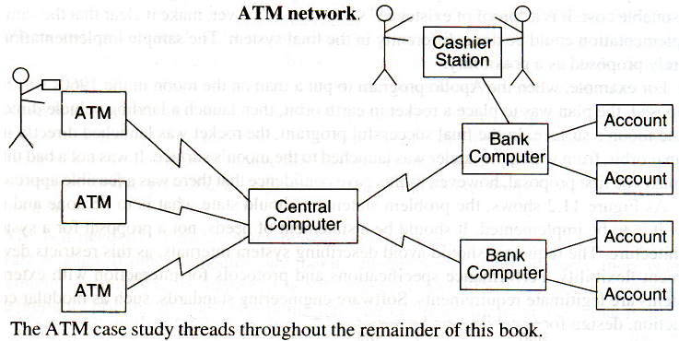
The ATM case study

Slide 17
Domain Analysis
**

Slide 18
Domain Analysis, the next stage of development, is concerned with devising a precise, concise, understandable and correct model of the real world.
It focuses on real world things whose semantics the application captures.
To build a domain model, you must interview business experts, examine requirements statements, and scrutinize related artifacts.

Slide 19
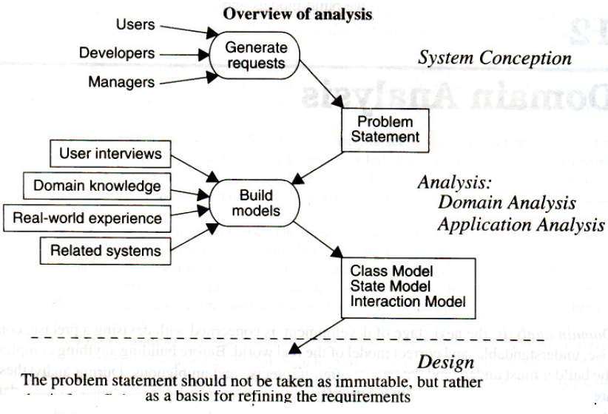

Slide 20
The first step in analyzing the requirements is to construct a domain model. The domain model shows the static structure of the real-world system and organizes it into workable pieces.

Slide 21
Steps to construct a domain class model: **
Find classes and keeping the Right Classes
Prepare a data dictionary.
Find associations and keeping right associations.
Find attributes of objects and links and keeping the right attributes.
Organize and simplify classes using inheritance.
Verify that access paths exist for likely queries.
Iterate and refine the model.
Reconsider the level of abstraction.
Group classes into packages.

Slide 22
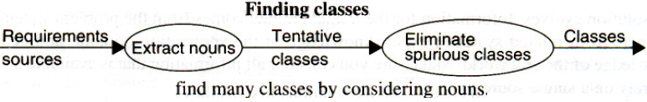
Finding Classes
Example: “a reservation system to sell tickets to performances at various theaters”
What are tentative classes,
Would be Reservation, System, Tickets, Performance, and Theater

Slide 23
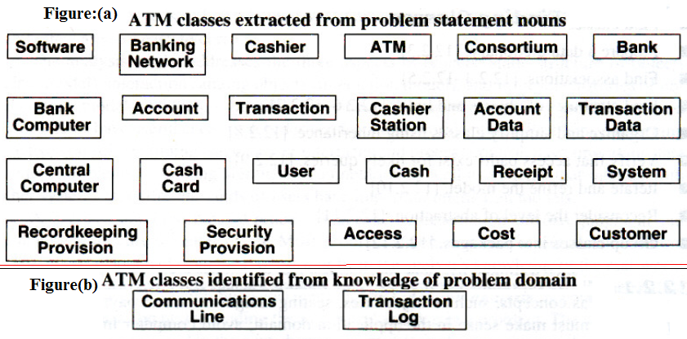

Slide 24
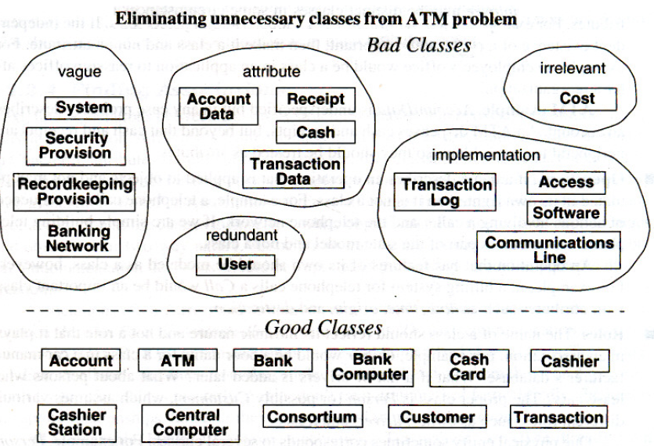
Keeping the right classes
Now discard unnecessary and incorrect classes according to the following criteria.

Slide 25
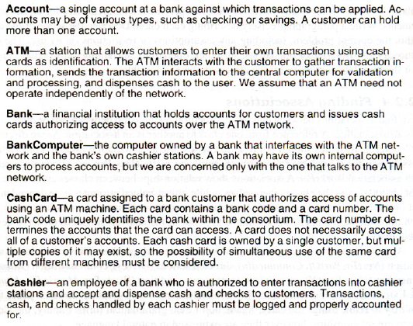
Prepare a Data dictionary
Prepare a data dictionary for all modeling elements. Write a paragraph precisely describing each class

Slide 26
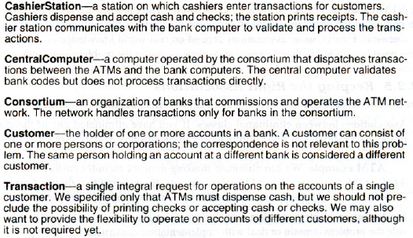

Slide 27
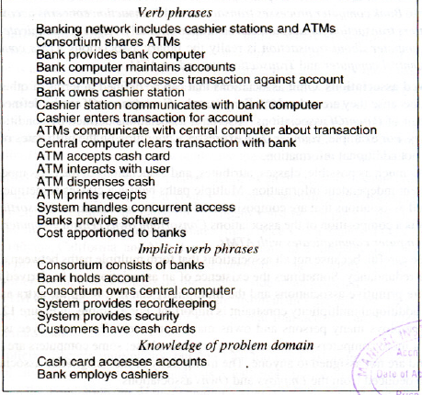
Finding Associations
A structural relationship between two or more classes is an association.
The majority are taken directly from verb phrases in the problem statement.

Slide 28
Keeping the right Associations
Association between eliminated classes:
Irrelevant or implementation associations:
Actions: An association should describe a structural property of the application domain, not a transient event.
ATM accepts cash card describes part of the interaction cycle between an ATM and a customer, not a permanent relationship between ATMs and cash cards.

Slide 29
Ternary Associations: Decompose most associations among three or more classes into binary associations / Qualified associations.
ATM example: Bank computer process transaction against account can be broken into bank computer process transaction and transaction concerns account.
Association End names:
Multiplicity:
Aggregation: ATM example --bank is a part of a consortium and indicate the relationship with aggregation.

Slide 30
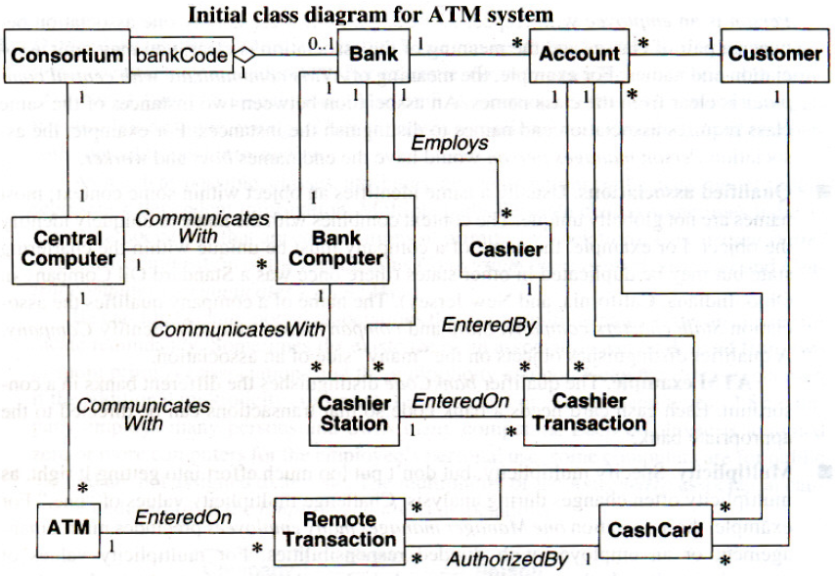

Slide 31
ATM Class Model with Attributes

Slide 32
Refining with inheritance
The next step is to organize classes by using inheritance to share common structure.
Inheritance can be added in two directions:
By generalizing common aspects of existing classes into a super class( bottom up)
By specializing existing classes into multiple subclasses(top down)
Apply Multiple inheritance if needed.

Slide 34
Testing Access Paths
Trace access paths through the class model to see if they yield sensible results.
Where a unique value is expected, is there a path yielding a unique result? For multiplicity "many" is there a way to pick out unique values when needed? Some likely questions can be thought of. Are there useful questions that cannot be answered? They indicate missing information.
One can use OCL-object constraint Language.

Slide 35
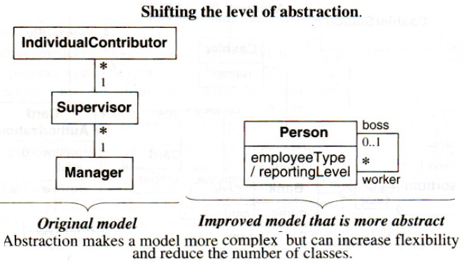

Slide 36
Grouping Classes into Packages
A package is a group of elements (classes, associations, generalizations, and lesser packages) with a common theme.
ATM example:
tellers-cashier, entry station, cashier station, ATM
accounts-account, cash card, card authorization, customer, transaction, update, cashier transaction, remote transaction
banks - consortium, bank

Slide 37
Domain State Model **
Steps in constructing a domain state model:
Identify domain classes with states.
Find states.
Find events.
Build state diagrams.
Evaluate state diagrams.

Slide 38
Identifying Classes with States:
List of domain classes are examined for those that have a distinct life cycle.
E.g. a scientific paper for a journal goes from Being written to Under consideration to Accepted or Rejected.
ATM example: Account is an important business concept, and the appropriate behavior for an ATM depends on the state of an Account.

Slide 39
Finding States:
List the states for each classes.
ATM example: Here are some states for an Account: Normal (ready for normal access), Closed (closed by the customer but still on file in the bank records), Overdrawn (customer withdrawals exceed the balance in the account), and Suspended (access to the account is blocked for some reason).

Slide 40
Finding Events:
Once the preliminary set of states is obtained, the events that cause transitions among states are found. The stimuli that cause a state to change be considered.
ATM example: Important events include: close account, withdraw excess funds, repeated incorrect PIN, suspected fraud, and administrative action.

Slide 41
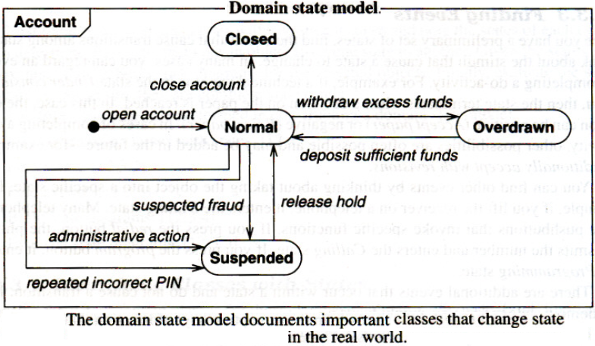
Building State Diagrams
The states to which each event apply is noted. Transitions are added to show the change in state caused by the occurrence of an event when an object is in a particular state.

Slide 42
Evaluating State Diagrams
Each state model is examined. Are all the states connected?
Paths through it are paid much attention.
is there a path from the initial state to the final state?
Are the expected variations present?
Are there any dead states that terminate the cycle?

Slide 43
Iterating the Analysis
Most analysis models require more than one pass to complete.
most applications cannot be approached in a completely linear way, because different parts of the problem interact.

Slide 44
Refining the Analysis Model
Classes need to be refined to increase sharing and improve structure.
Some constructs will feel awkward and won't seem to fit in right. They must be reexamined carefully; there may be wrong concepts.
Remove attributes, associations, and operation that seemed useful at first but now appear extraneous.

Slide 45
Restating the Requirements
The final model is verified with the requestor. During analysis some requirements may appear to be incorrect or impractical; corrections to the requirements are confirmed.
Also business experts should verify the analysis model to make sure that it correctly models the real world.

Slide 46
Application Analysis
Application Interaction Model
The focus of domain modeling is on building a model of intrinsic concepts. After completing the domain model, the details of an application and interaction are considered.

Slide 47
Steps to construct an application interaction model:
Determine the system boundary.
Find actors.
Find use cases.
Find initial and final events.
Prepare normal scenarios.
Add variation and exception scenarios.
Find external events.
Prepare activity diagrams for complex use cases.
Organize actors and use cases.
Check against the domain class model

Slide 48
Determining the System Boundary
System boundary is the precise scope of an application and its functionality. It decides what the system includes and, more importantly, what it omits.
ATM E.g. Consider the software design to support a computerized banking network including both human cashiers and automatic teller machines [ATM].

Slide 49
Finding Actors
Actors are the external objects that interact directly with the system.
For the ATM application, the actors are Customer, Bank, and Consortium.
Finding Use Cases
Each actor may use the system in different ways. Such fundamentally different ways for each actor is listed. Each of these ways is a use case.

Slide 50
Use case diagram for ATM

Slide 51
Finding Initial and Final Events for each use case
Initiate session->The initial event is the customer's insertion of a cash card. There are two final events: the system keeps the cash card or the system returns the cash card.
Query account-> The initial event is a customer's request for account data. The final event is the system's delivery of account data to the customer.
Process transaction-> The initial event is the customer's initiation of a transaction. There are two final events: committing or aborting the transaction.
Transmit data.->The initial event could be triggered by a customer's request for account data. The final event is successful transmission of data.

Slide 52
Preparing Normal Scenarios

Slide 53
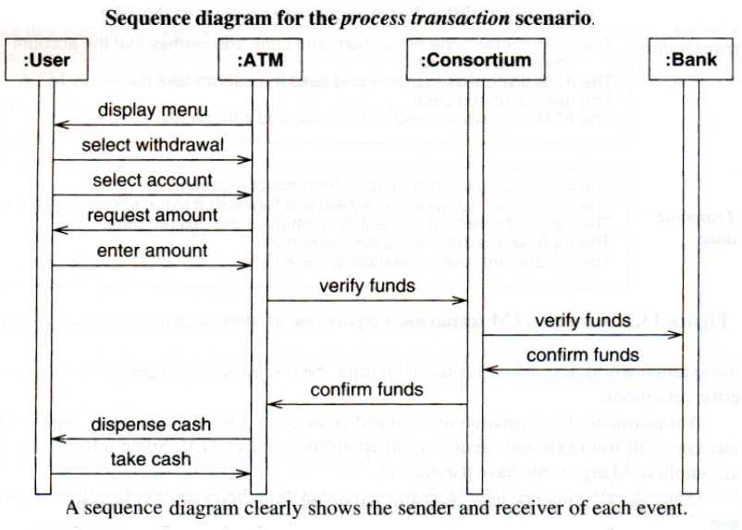

Slide 54
Adding Variation and Exception Scenarios
The ATM can't read the card.
The card has expired.
The ATM times out waiting for a response.
The amount is invalid.
The machine is out of cash or paper.
The communication lines are down.
The transaction is rejected because of suspicious patterns of card usage.

Slide 55
Preparing Activity Diagrams for Complex Use Cases
Sequence diagrams capture the dialog and interplay between actors, but they do not clearly show alternatives and decisions.
Activity diagrams consolidate all this behavior by documenting forks and merges in the control flow.

Slide 56
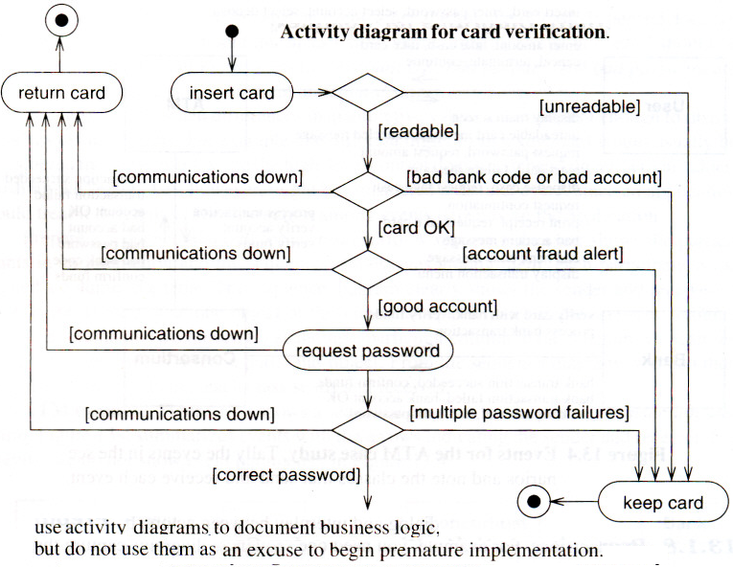

Slide 57
Application Class Model
Application classes define the application itself, rather than the real-world objects that the application acts on.
Most application classes are computer-oriented and define the way that users perceive the application.
Steps in constructing application class model:
Specify user interfaces.
Define boundary classes.
Determine controllers.
Check against the interaction model.

Slide 58
Specifying User Interfaces
Most interactions can be separated into two parts:
Application logic and
User interface
A user interface is an object or group of objects that provides the user of a system with a coherent way to access its domain objects, commands, and application options. During analysis the emphasis is on the information flow and control, rather than the presentation format.

Slide 59
Figure shows a possible ATM layout

Slide 60
Defining Boundary Classes
A system must be able to operate with and accept information from external sources
It is often helpful to define boundary classes to isolate the inside of a system from the external world.
A boundary class is a class that provides a staging area for communications between a system and an external source
ATM example: It would be helpful to define boundary classes (CashCardBoundary, AccountBoundary) to encapsulate the communication between the ATM and the consortium.

Slide 61
A controller is an active object that manages control within an application. It receives signals from the outside world or from objects within the system, reacts to them, invokes operations on the objects in the system, and sends signals to the outside world.

Slide 62
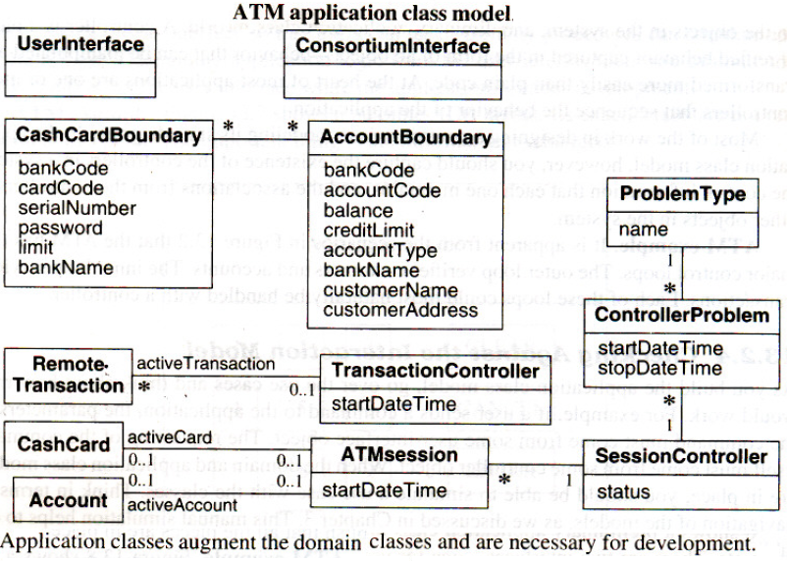
Checking Against the Interaction Model

Slide 63
Application State Model
The application state model focuses on application classes and augments the domain state model.
Steps in construction an application state model:
Determine application classes with states.
Find events.
Build state diagrams.
Check against other state diagrams.
Check against the class model.
Check against the interaction model.

